Slide 1

Writing Progression Booklet
Non-fiction

Slide 2
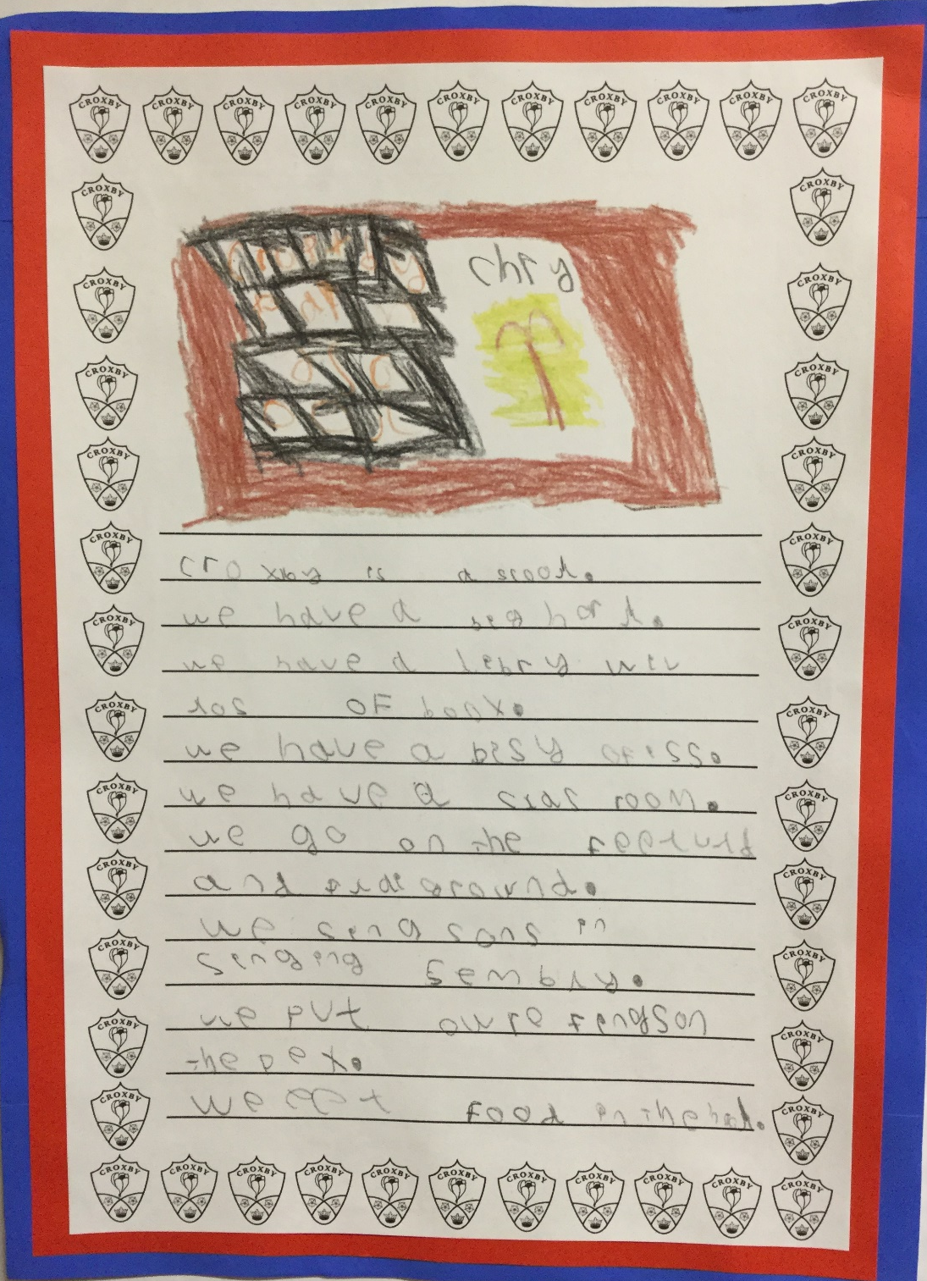
Foundation Stage:
Combines words to make sentences.

Slide 3
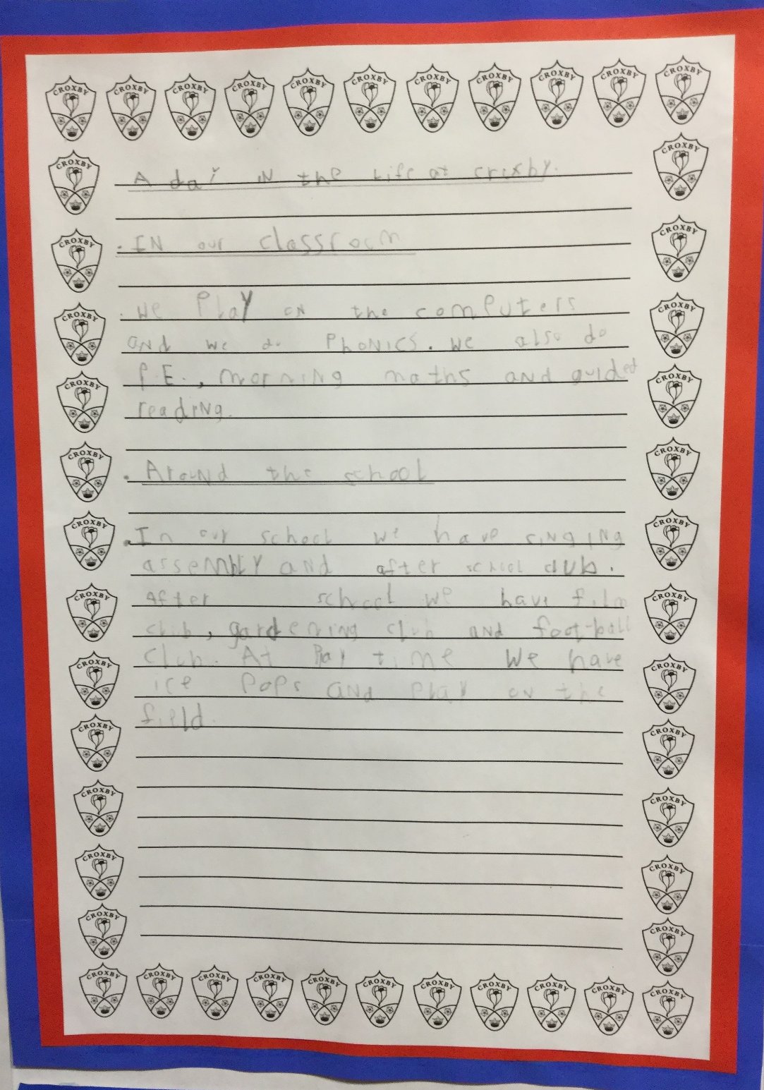
Year 1:
Combines words to sequence sentences into information text.

Slide 4
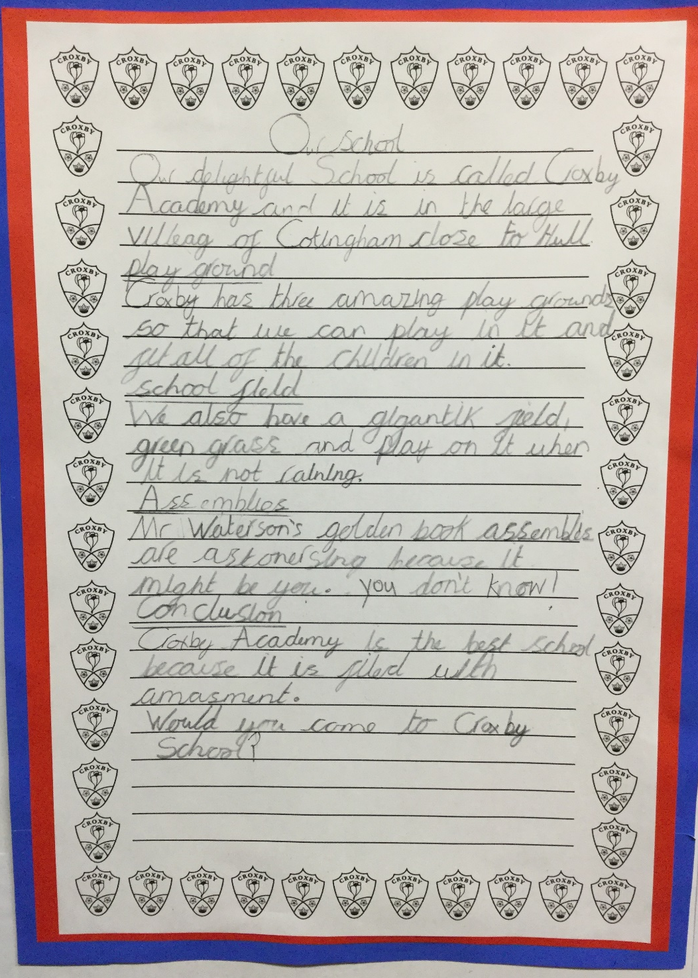
Year 2:
Sequence sentences appropriately to create an information text.

Slide 5
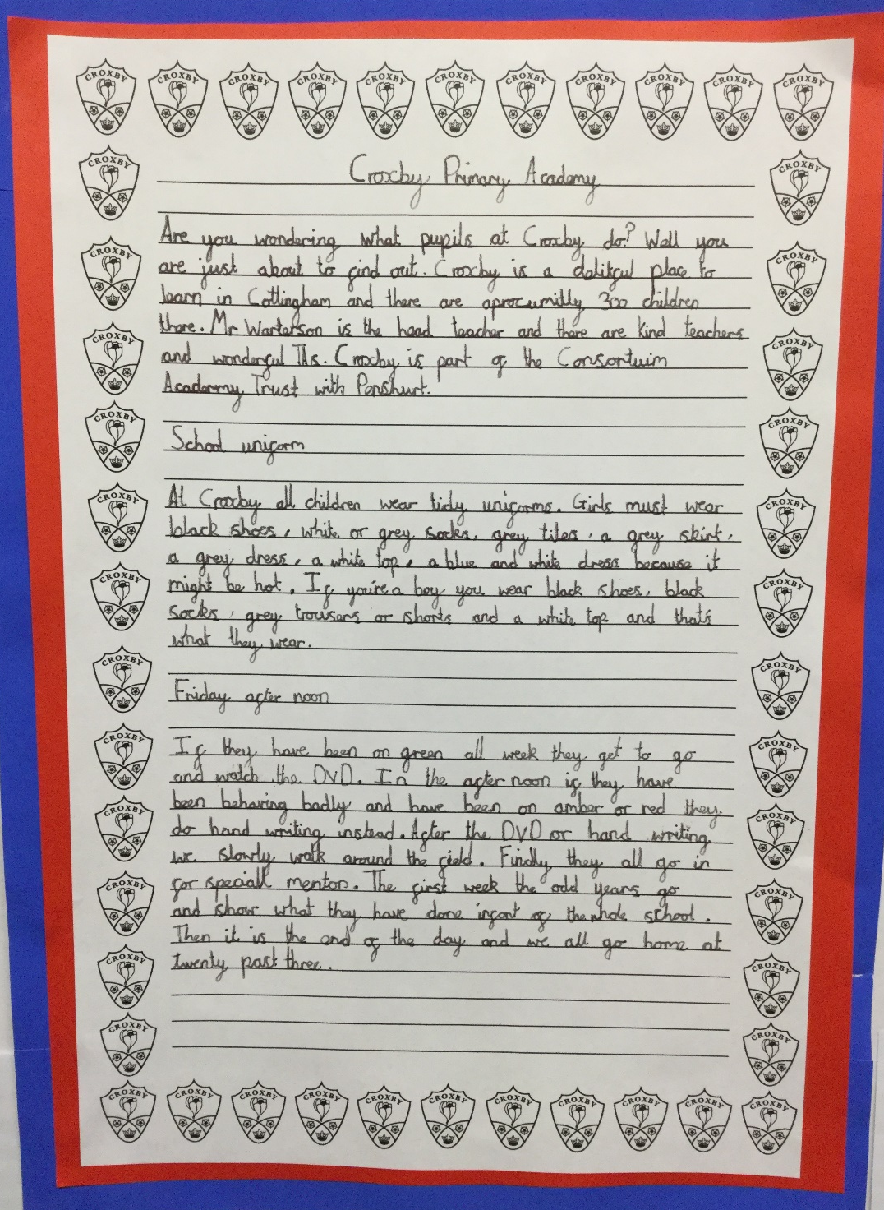
Year 3:
Sequence and organise sentences, sometimes including some simple devices, to create an information text.

Slide 6
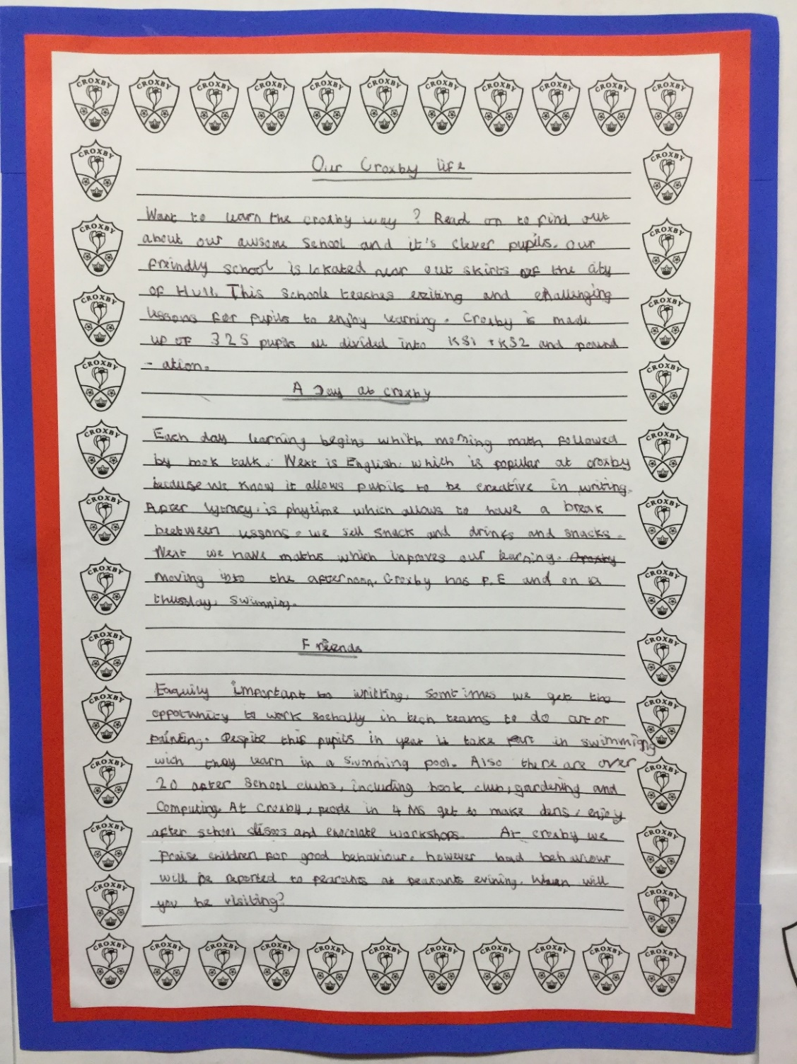
Year 4:
Using simple organisational devices to structure an information text.

Slide 7
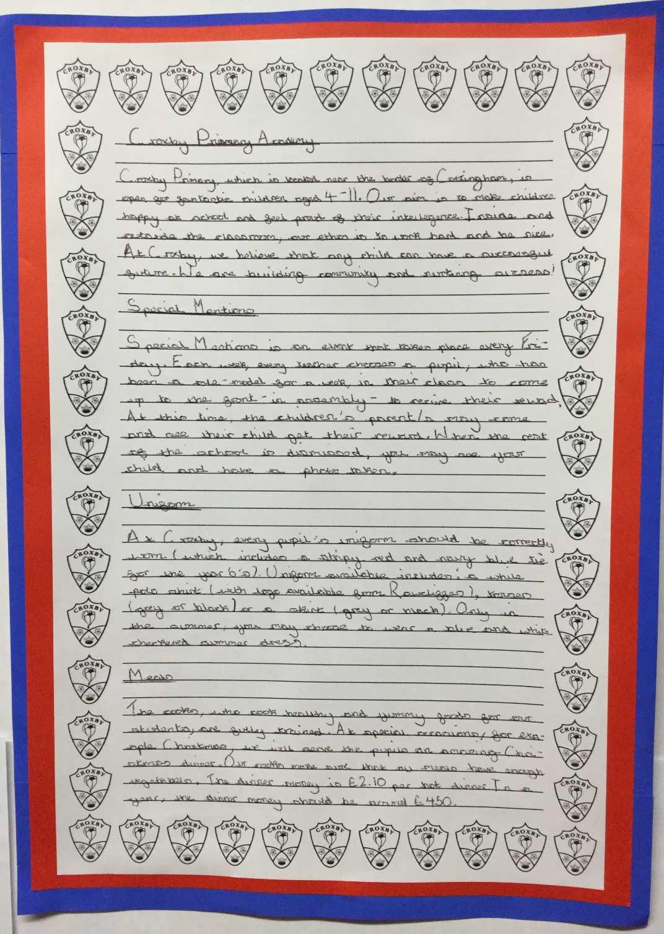
Year 5:
Using further organisational devices to structure an information text to guide the reader.

Slide 8
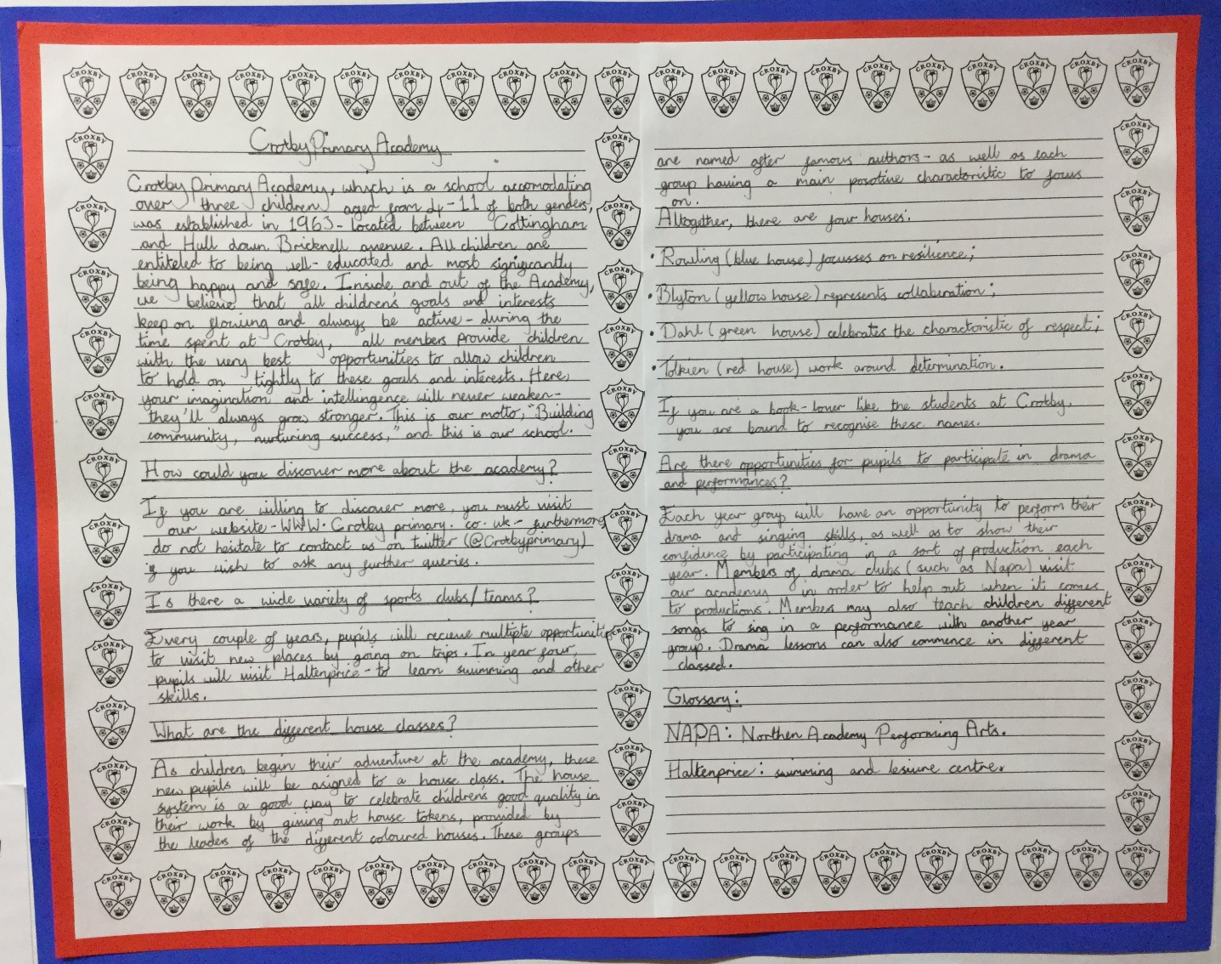
Year 6:
Using more complex organisational and presentational devices to structure an information text to guide the reader.

