Slide 1
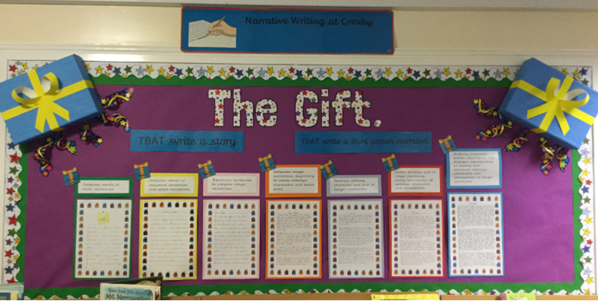
Writing Progression Booklet Fiction

Slide 2
Foundation Stage:
Combines words to make sentences.

Slide 3
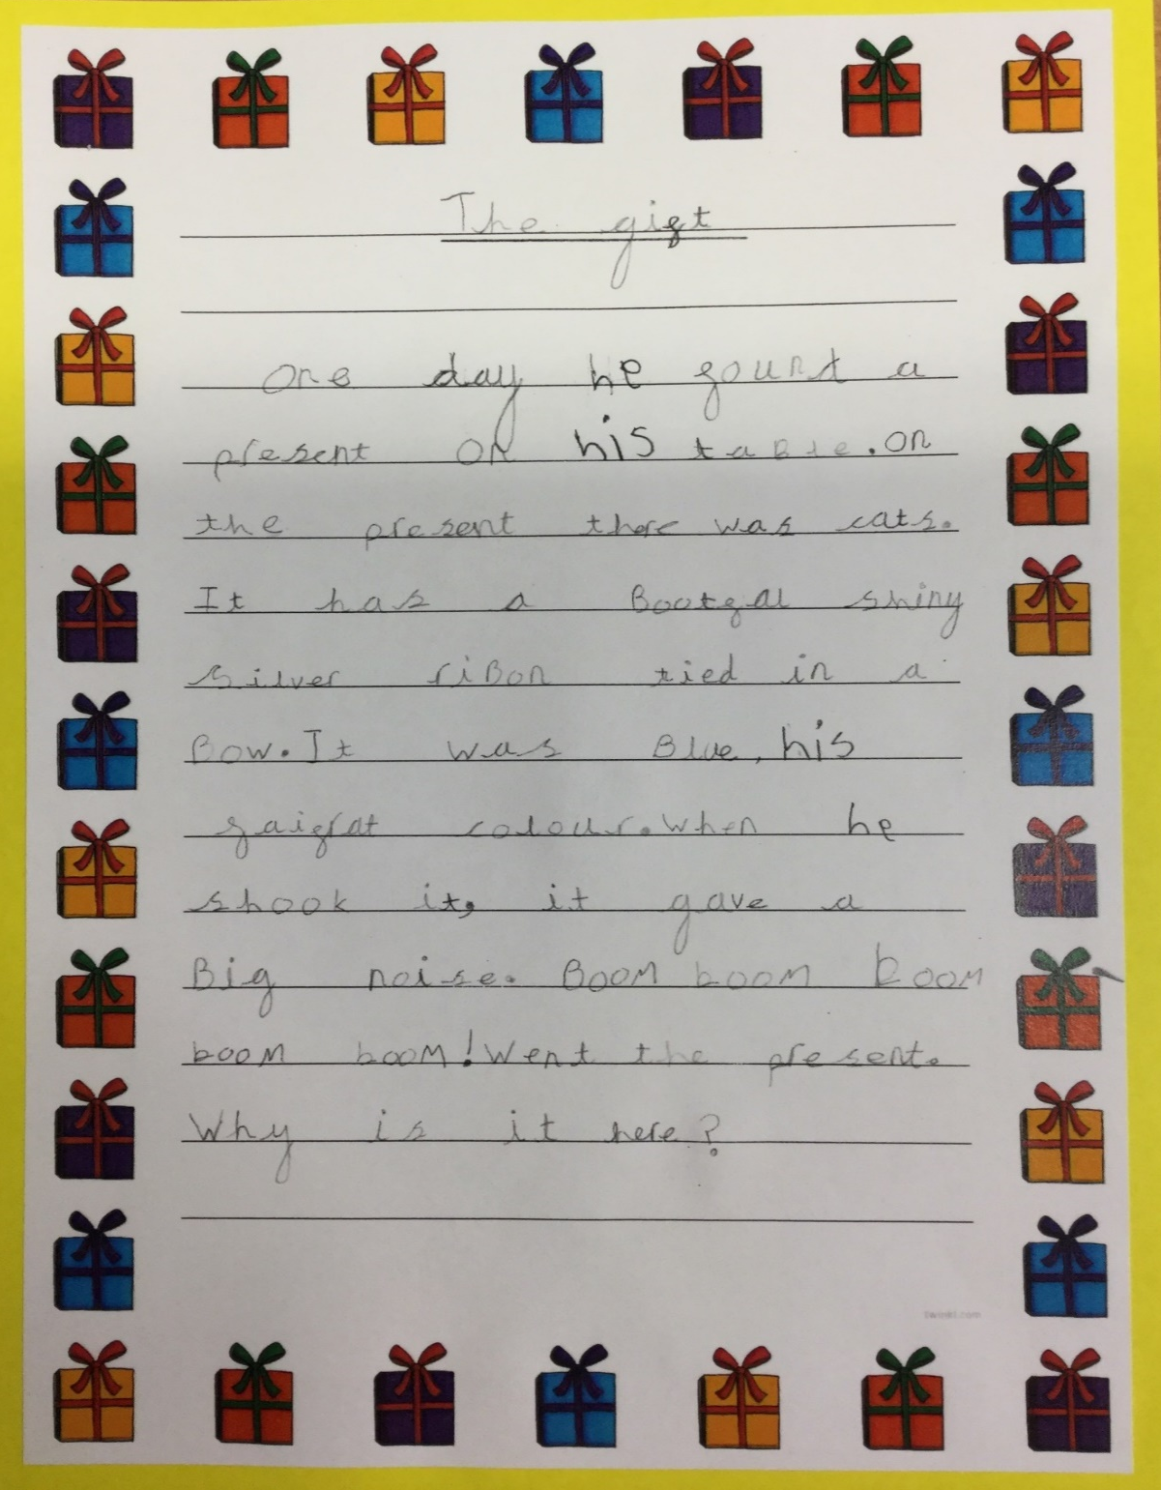
Year 1:
Combines words to sequence sentences into short narratives.

Slide 4
Year 2:
Sequences sentences to compose longer narratives.

Slide 5
Year 3:
Composes longer narratives, beginning to create settings, characters and basic plots.

Slide 6
Year 4:
Develops setting, character and plot in longer narratives.

Slide 7
Year 5:
Further develops plot in longer narratives, using descriptions of settings, characters and atmospheres.

Slide 8
Year 6:
Skilfully integrates action, description and dialogue appropriately to develop and establish settings, characters and atmospheres in longer narratives.

